Slide 1
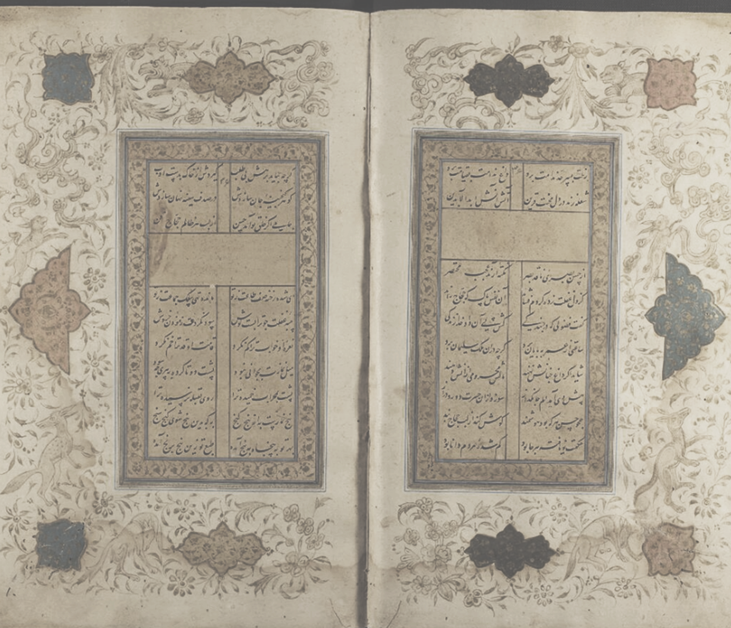

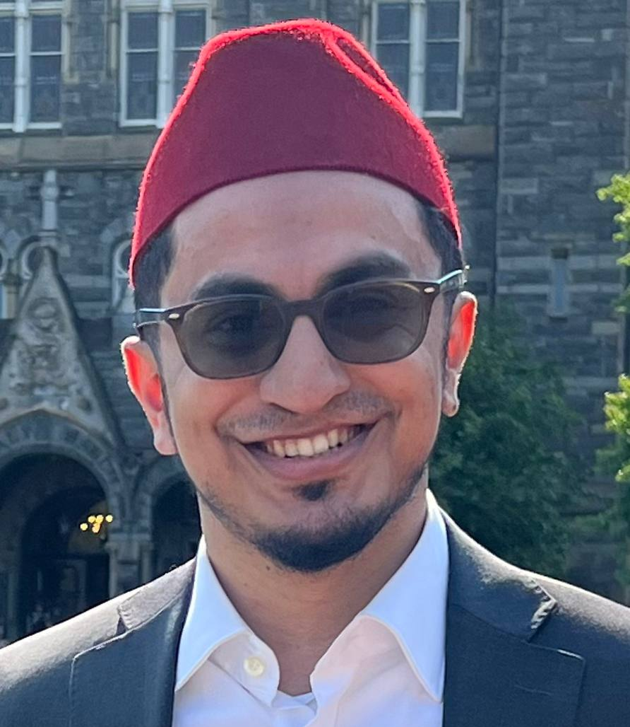


FINDING GOD: Understanding The Spiritual Path al-Suhrawardi’s Portrait of a Sincere Seeker Explained
an introduction to the teachings of Sufism, the meaning of shaykhs, the purpose of and obstacles on the path, and the traits of a sincere seeker
with Ustadh
Abdullah Qureshi
May 30 – May 31
11:30am - 6:30pm

